Slide 1
Welcome to the
Louisiana Recycling Coalition
General member meeting
5/9/2017
10:30AM-12:30pm
Ernest Morial Convention Center
900 Convention Center Blvd.
New Orleans, LA 70130
Room: 243-245

Slide 2
Agenda
Mission Statement
Committee Overview
Presenters:
  Ron Vance – EPA
  Don Caffery – LDEQ
  Chris Coady – Recycling Partnership
Member Benefits and Organizational Goals
Membership Levels/Webpage Intro
Questions and Feedback

Slide 3
Mission Statement
The Louisiana Recycling Coalition is a membership based network of individuals and representatives from government, industry, and non-profit entities that support environmental stewardship through materials reduction, reuse, and recycling in Louisiana. The Louisiana Recycling Coalition provides advocacy, information, technical support, networking, and educational opportunities for and about recycling in partnership with local, state, regional and national organizations.

Slide 4
Committee Overview
  Recycling Infrastructure:
    Researches current recycling metrics (tonnages, distance traveled, etc.) to set goals and find appropriate technology to warrant new and more localized MRFs, transfer stations, and hauling contracts.
  Industry Development
    Supports and reports upon the establishment of end market processors for recyclable commodities.
  Education and Economic Information
    Creates Louisiana specific recycling educational material which includes information about the actual cost of recycling.
  State Policy
    Works with state agencies to improve reporting and measurements for diversion rates, and found state-wide programs for Regular and hard to recycle materials.

Slide 5
“You can’t manage what you can’t measure.”
How measuring and reporting recycling data can guide, justify, and support our work in reaching recycling goals

Slide 6
Speaker Introduction
Ron Vance – EPA
  Offers a summary of recent findings in the EPA's Facts and Figures Report, will explain the benefits of and tools available for state reporting on the national level.

Slide 7
EPA Measurement Programs
Ron Vance, Chief
Resource Conservation Branch
Resource Conservation and Sustainability Division
U.S. Environmental Protection Agency
Louisiana Recycling Association
May 9, 2017
Notes:
My name is Ron Vance and I am Chief of the Materials Conservation and Recycling Branch for the U.S. Environmental Protection Agency in Washington DC. One of my roles is overseeing our national measurement efforts related to Sustainable Materials Management.

Slide 8
Outline
Benefits of Measurement and Reporting
Facts and Figures
  Overview and updates
  Key data and trends
Recycling Economic Information (REI) Jobs Report
  Study overview
  New definition of recycling
  REI Methodology
State Measurement Program
  Overview
  Timeline Growth
  Benefits to States
  Data collection and Review
Notes:
REI Report
In 2001, EPA introduced the first analysis of the economic benefits of recycling and supported the creation of a national Recycling Economic Information (REI) Study, based on the work of several states and regions. The study included an analysis of jobs in the recycling sector.
In 2016, EPA the next iteration of the REI study including an updated definition of recycling, new estimates of numbers of jobs, wages and tax revenues created by recycling, and a refined analytical methodology to help policy makers.

Slide 9
Why Measure?
Data provides valuable trend and historical analysis.
Data is used by businesses, local and state governments, trade associations and the public to:
  Set strategic planning goals
  Plan solid waste management strategies
  Target technical assistance
  Inform standards development
  Assess market potential
  Transform benchmarking into best practice solutions

Slide 10
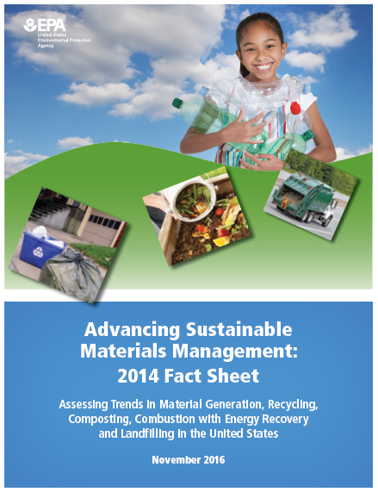
Facts & Figures
New for 2014 report:
  Replaced recovery and disposal with generation, recycling, combustion and landfilling.
  New methodology updates for electronics and construction and demolition debris (C&D).
Notes:
So let’s start with some of highlights from this year’s report.
The title Sustainable Materials Management (SMM) Fact Sheet suggests that EPA is thinking beyond waste. SMM refers to the use and reuse of materials in the most productive and sustainable way across their entire life cycle. SMM conserves resources, reduces waste and minimizes the environment impacts of the materials we use.
We also changed the way we described the waste management pathways—historically we used terms like recovery and disposal. We are now delineating the specific pathways including generation, recycling, combustion, and landfilling.
We also used new updated methodology to estimate electronics and C&D waste.
EPA has collected and reported data on the generation and disposal of waste in the United States for more than 30 years. We use this information to measure the success of waste reduction and recycling programs across the country and characterize our national waste stream. The facts and figures are current through calendar year 2014.
Each year we issue a summary Fact Sheet, which is accompanied by a set of about 60 Tables and Figures, with the detailed supporting data.

Slide 11
Methodology
Scope
Municipal solid waste, or trash
Includes packaging, food, yard trimmings, furniture, electronics, tires, and appliances
Sources of MSW
Residential waste
Institutions such as schools, hospitals, and prisons and commercial sources such as restaurants, office buildings, and retail establishments
Materials Flow Approach
Based on national data, which characterizes waste stream of the nation as a whole
A top-down approach (not a state-by-state or facility-by facility approach)
Sources of Data
Industry associations
Government data sources such as the Department of Commerce and the U.S. Census Bureau
Other sources of data such as state websites.
Notes:
MSW or trash refers to items we throw after their use. It does not include industrial, hazardous or C&D waste
MFA is a top down approach that estimates generation by taking total domestic supply of materials and adjusting it for imports/exports and diversion to estimate generation.

Slide 12
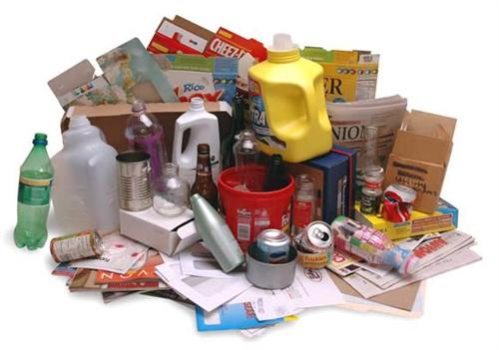
Key Data (Generation)
258 million tons of MSW generated
  4.44 pounds per person, per day
  Increase of 3 million tons (0.02 pounds per day)
38.4 million tons of wasted food generated
  241 pounds per person per year
  Increase of 7 pounds per year
  Composting rose 100,000 tons (0.1%)
Other generation numbers
  Yard trimmings
  Paper
  Plastics
Notes:
How is waste generated?

Slide 13

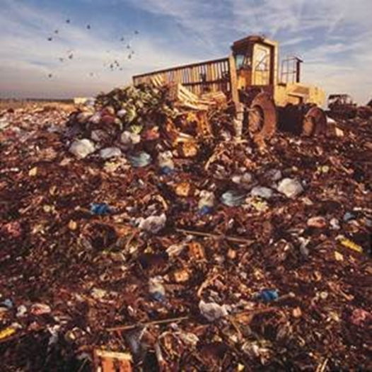
Key Data (Management)
34.6 % recycled
  Includes both recycling and composting
  89 million tons
12.8% combusted (with energy recovery)
  33 million tons
52.6% landfilled
  136 million tons
Notes:
How is waste managed?

Slide 14
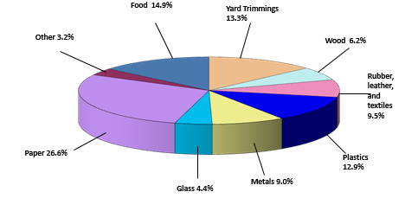
Municipal Solid Waste Generation in 2014
258.5 Million Tons (before recycling)
Notes:
This pie chart shows generation of MSW by material in 2014.
Paper made up 26.6 percent of what was generated.
Food was 14.9 percent, while yard trimmings made up 13.3 percent.
Plastics made up 12.9 percent, followed by rubber, leather, and textiles which together made up 9.5 percent.
Metals made up 9.0 percent.
Wood came in at 6.2 percent, glass at 4.4 percent, and other at 3.2 percent.
Organics are the largest percentage of the waste stream (paper, food and yard trimmings): 54.8

Slide 15
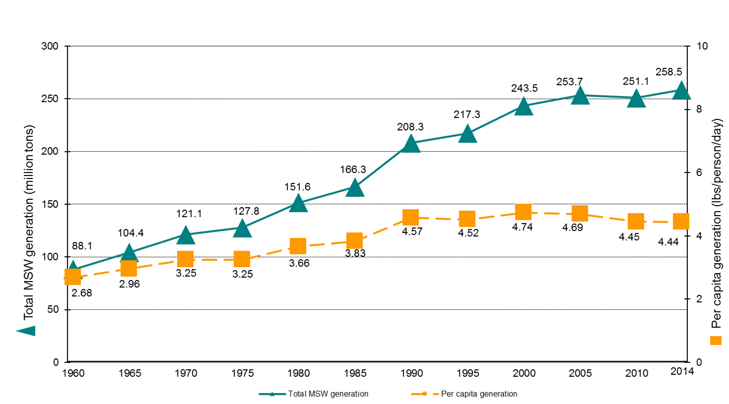
MSW Generation Rates, 1960 to 2014
Notes:
The upper line in this figure shows total MSW generation over time.
The lower line shows per capita MSW generation over time.
MSW generation has increased with population but per capita generation has levelled off.
MSW generation per person peaked at 2000. The 4.4 pounds/per day per person in 2014 is the same as 2013 and the lowest since 1980.

Slide 16
Indexed MSW Generated and Real PCE over Time (1960-2014)

Slide 17
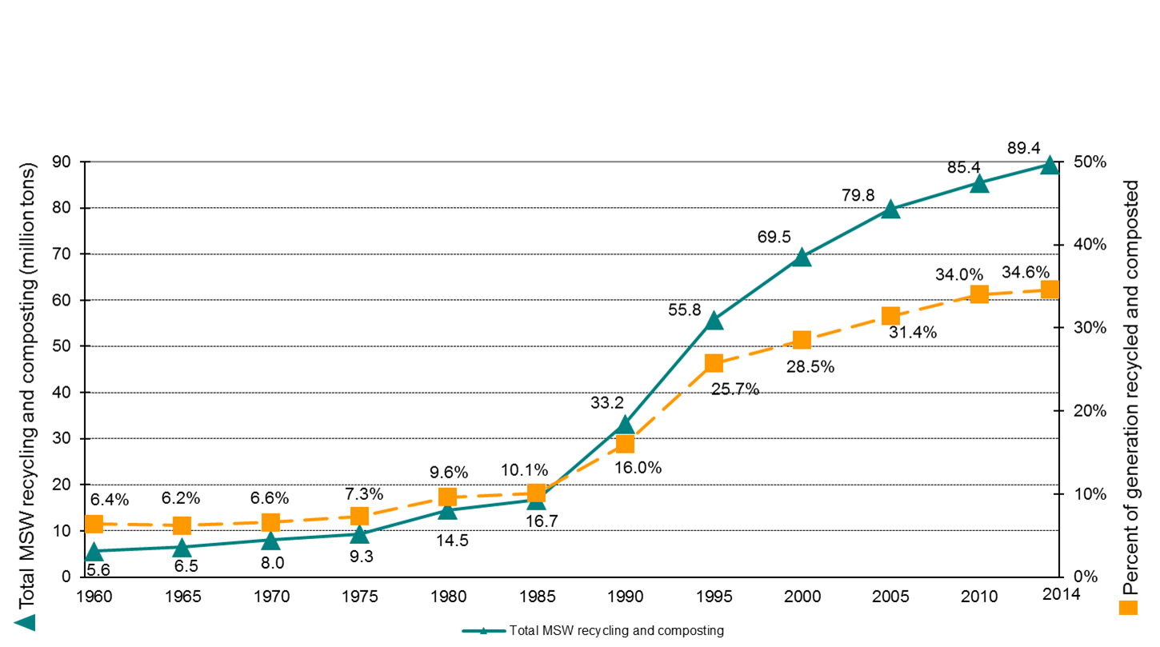
MSW Recycling Rates, 1960 to 2014
Notes:
In this slide, the blue line shows total MSW recycling and composting in the U.S, in millions of tons, from 1960 to 2014.
The orange line shows the recycling and composting rate, over time, in the United States with the dramatic growth from 1980-2000 when there was a focus on the issue.
Recycling has leveled off for the past 10 years.

Slide 18
Recycling and Composting Rates of Select Products

Slide 19
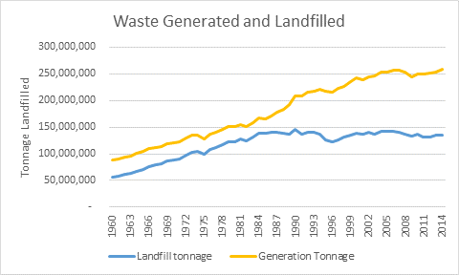
Historic Landfilling Rates

Slide 20
Recycling Economic Information (REI)
First national REI study since 2001
The 2016 study:
  Explores alternative approaches to measuring economic impacts of recycling
  Provides a new definition of recycling
  Addresses key areas of uncertainty in the 2001 study
  Uses a Waste Input-Output (WIO) model that distinguishes recycling/ recyclable material flows within economic sectors
Notes:
In 2001, EPA introduced the first analysis of the economic benefits of recycling and supported the creation of a national Recycling Economic Information (REI) Study, based on the work of several states and regions. The study included an analysis of jobs in the recycling sector.
In 2016, EPA the next iteration of the REI study including an updated definition of recycling, new estimates of numbers of jobs, wages and tax revenues created by recycling, and a refined analytical methodology to help policy makers.

Slide 21
2016 REI Summary
Recycling accounts for:
  757,000 jobs
    1.57 jobs per 1,000 tons
  $36.6 billion in wages
  $6.7 billion in tax revenues
Most significant contributors to the national economy
  Metals (ferrous and non-ferrous)
  Construction and demolition (C&D)
The 2007 BEA numbers will updated in 2017
Notes:
757,000 jobs
$36.6 billion in wages
$6.7 billion in tax revenues
Every 1,000 short tons of recyclables creates:
1.57 jobs
BEA numbers are updated every 10 years.

Slide 22
REI Methodology: Intermediate Approach
Delineates activities as direct or indirect
Direct activities are those associated with the transformation of recyclable materials into marketable products
  Example: the transformation of aluminum scrap into semi-fabricated products (ingots) in a secondary smelter
Indirect activities are those associated with recycling, reuse, and food donation include the value chain of direct processes
  Example: the collection, sorting, and transportation of aluminum scrap to the smelter or the transportation of donated food from the food bank to the local food pantry

Slide 23
REI Methodology
Waste Input-Output (WIO) Table
  Augments national input-output table by the Bureau of Economic Statistics (BEA) distinguishing:
    Flows of recyclables;
    Flows of recycled products/materials; and
    Recycling industries.
  Uses nine major material categories
    Ferrous metals, Aluminum, Paper, Glass, Plastics, Rubber, Electronics, Construction & Demolition and Organics

Slide 24
State Measurement Program (SMP)
  Voluntary web-based information program started in 2013 providing municipal solid waste (MSW), recycling composting and waste-to-energy information from states. The program:
  Addresses differences in state recycling rates
  Establishes common data templates
  Facilitates bottom-up data collection
  Allows “apples-to-apples” state comparisons
  Allows city and facility level participation
  Allows for a single forum for both policy and results

Slide 25
SMP Timeline and Growth
2007-2011
  Started in Tennessee with all eight states in EPA Region 4
  Developed state sharing data template
2013-2014
  20 states fully participated in 2012 template
  50 states added the Sustainable Material Management (SMM) Resource Module (Planning, Policy Drivers, Administrative Info)
2014-2015
  32 states and the District of Colombia participated in 2013 template
2016-2017
  31 states participated in the 2014 template
  32 states and the District of Columbia participated in the 2015 template

Slide 26
Benefits to States
Provides free options to state and local governments
Creates a national data clearinghouse
Maintains integrity of each state’s program
Provides the ability to map sources/locations of materials
Encourages peer-to-peer networking
Transforms benchmarking data into a series of best practice publications or workshops to help state officials improve their programs
Provides local, state and regional policy makers with data to drive program success

Slide 27
SMP Data Collection Process
SMP provides qualitative state program data (called module) and facility-based quantitative data (called template)
The module includes information on state and local planning goals and specific materials management strategies.
The template consists of 15 questions that allows states to share information.
Notes:
Strategies in the module include: life-cycle based approaches, source reduction, recycling market development, product stewardship, pay-as-you-throw, environmentally preferable purchasing and material-specific efforts. A limited number of materials are specifically addressed in the current module, including organics (food and yard waste), electronics, construction and demolition materials, packaging and tires.
State governments and the EPA can generate a series of analytical reports that summarizes, aggregates and presents the data on a state, regional and national level.
Template questions include annual tonnage (waste, recycling, composting, etc.) descriptions of the types of waste and recycling programs in the state and financial summaries of programs are staffed and funded.

Slide 28
SMP
Template
SMM Resource Module
Feedback Form
Demographics Template
States submit Quantitative Data: Recycling, Disposal, and SMM information
Provides Programmatic/ Qualitative information for all 50 States
States provide yearly feedback to the SMP
Re-TRAC pulls from US Census Bureau
5
Notes:
The graphs illustrates the annual review and comment process, including state feedback.
Four major components that feed into Re-TRAC Connect: State Template, Resource Module, Feedback Form and Demographics template
Now we have collected data from nearly every state. Most having disposal numbers to some with only programmatic information
But now the framework is in place.

Slide 29
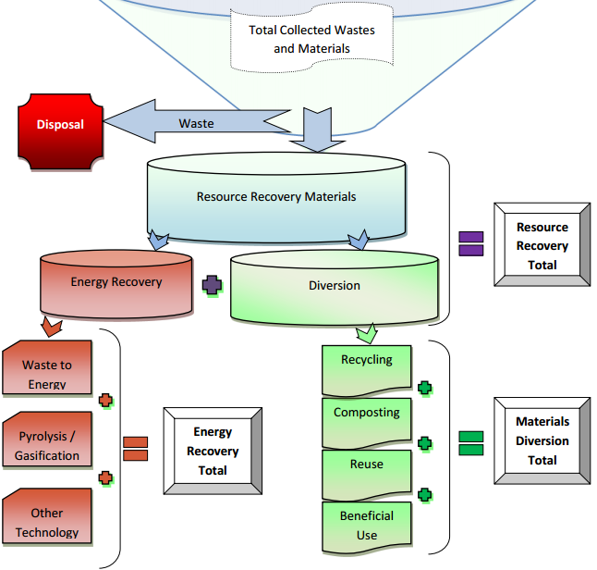
Notes:
This is an example of the materials management flow diagram used by states

Slide 30
How to Participate
Must have state email address
Create a free Re-TRAC Connect Account
  https://coonect.re-trac.com
Log into Re-TRAC Connect and click “Programs”
Select “State Measurement Program”
Click “Join”

Slide 31
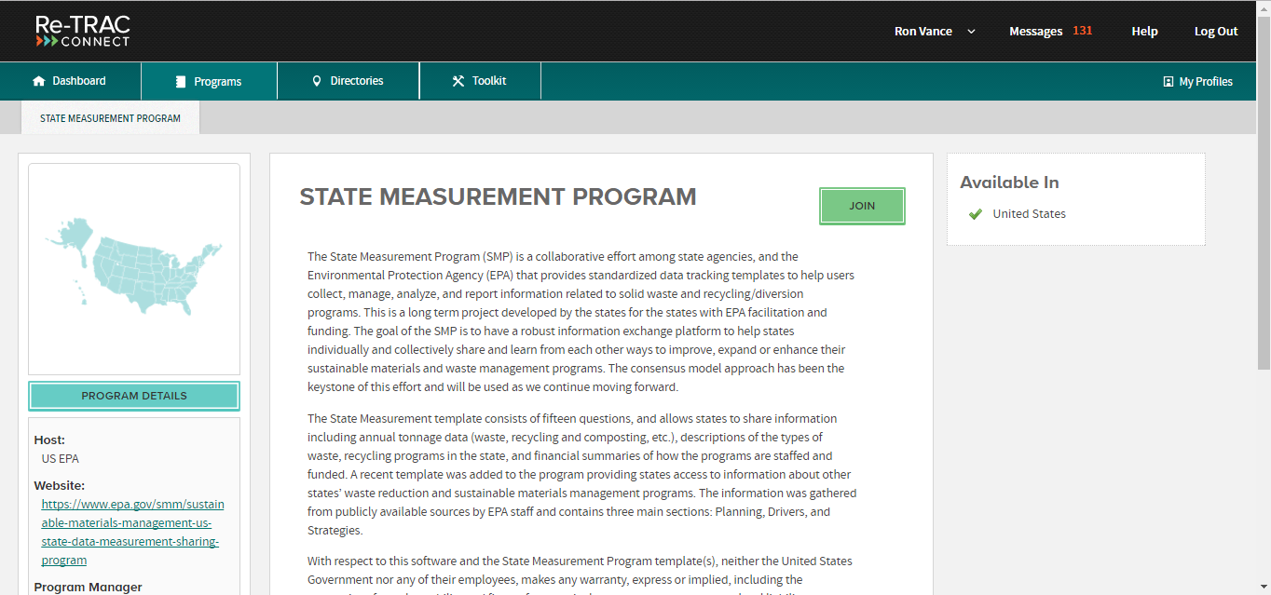
How to Participate

Slide 32
Thank you!
Visit us at:
http://www.epa.gov/smm
Questions? ORCRMeasurement@epa.gov
Notes:
Tools and resources will have the links to both the reports.

Slide 33
Speaker Introduction
Don Caffery – LDEQ
  Presents previously unpublished state-wide recycling statistics and investigates the need for improvement in recycling reporting in Louisiana.

Slide 34

Coming to Grips with Recycling Measurement at the State Level
Don Caffery
Solid Waste Permits Engineer
Louisiana Department of
Environmental Quality
Notes:
Assigned job duties (not recycling)
History of your reporting

Slide 35
Annual Recycling Report
DEQ is required by law to compile a report each year on resource recovery and recycling programs in the parishes and municipalities in the state
25% waste reduction goal, other specifics in regulation LAC 33:VII.10307
Our statewide report to the Legislature is a compilation of the parish and city report forms that we receive
Presently we are asking for the information by October 1, for the preceding year

Slide 36
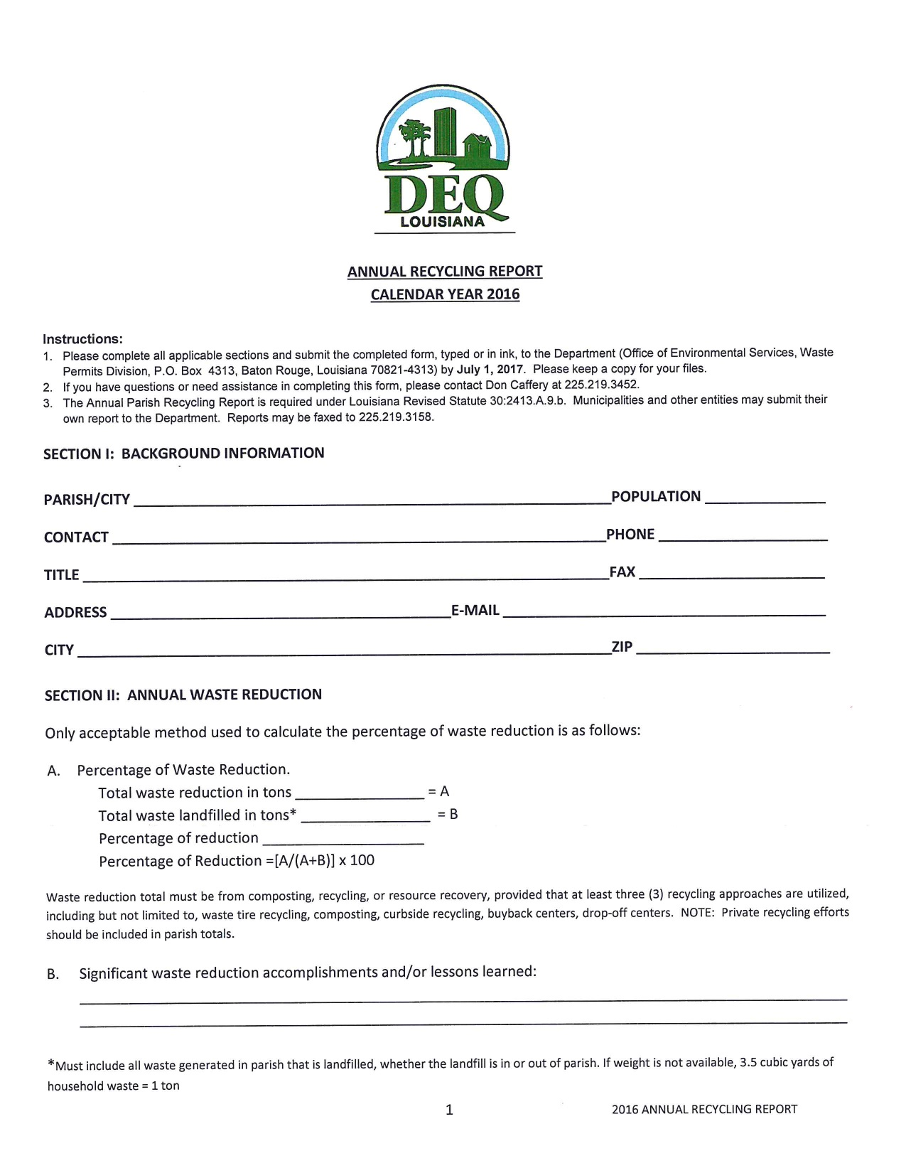

Slide 37
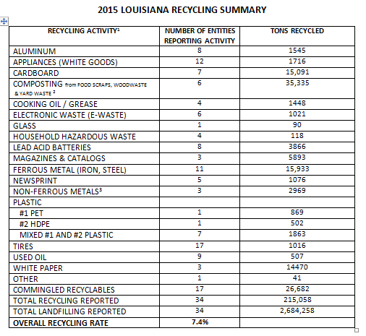

Slide 38
Highlights of 2015 Report
30 parishes (47 %) and 4 cities reported for 2015, representing 66% of Louisiana population
    Only 36% of population represented in 2014 report
7 parishes reported no recycling activities
34 parishes did not report
2015 report first one to report the overall recycling rate for the state: 7.4%

Slide 39
Parish or City | Curbside | Dropoff | HHW
Ascension | yes | yes | yes
Assumption | no | yes | no
Avoyelles | no | no | no
Beauregard | no | no | no
Bossier City | no | yes | no
Caddo (outside Shreveport) | no | yes | yes
Calcasieu | no | yes | no
Catahoula | no | no | no
Concordia | no | no | no
City of Covington | yes | no | no
East Baton Rouge | yes | yes | yes (twice/yr)

Slide 40
Parish or City | Curbside | Dropoff | HHW
East Feliciana | no | yes | no
Iberville | no | yes | no
Jackson | no | yes | no
Jefferson (unincorp. Areas) | yes | yes | yes (twice/yr)
Lafourche | no | yes | yes
City of Lake Charles | no | yes | no
Lincoln | no | yes | yes
Madison | no | no | no
Morehouse | no | yes | no
Natchitoches | no | yes | no
Orleans | yes | yes | yes

Slide 41
Parish or City | Curbside | Dropoff | HHW
Pointe Coupee | yes | yes | no
St. Landry | yes | yes | yes
St. Martin | yes | no | no
City of Shreveport | yes | no | yes (8 times/yr!)
Tangipahoa | yes | no | yes (twice/yr)
Tensas | no | no | no
Terrebonne | no | yes | no
Vermilion | no | yes | yes
Webster | no | no | yes (occasional)
West Baton Rouge | yes | yes | yes
Winn | no | yes | no

Slide 42
Issues With Parish Reports
Consistency of Participation
  5 parishes and 3 cities newly reported for 2015, but 9 parishes that reported for 2014 did not report
Completeness of Reports
  Parishes with no recycling did not provide any data (e.g., tons landfilled)
  Many parishes/cities provided only totals with no, or inadequate, breakdown of materials recycled (recyclers will not provide breakdown unless contract requires)
  Only two parishes reported recycling from private collectors (scrap metal and tires weigh a lot!!)

Slide 43
Challenges for the State Report
Get all parishes to report landfilled waste for an accurate basis
Should residential and commercial waste be combined, or reported separately?
Should public and private collections be combined, or reported separately?
LDEQ needs adequate resources to work one-on-one with parish & local recycling coordinators to maintain and improve reporting

Slide 44
Thank you for Participating!
Any Questions? Suggestions??
Don Caffery, P.E.
Waste Permits Division
Louisiana Department of Environmental Quality
(225) 219-3452
Donelson.caffery@la.gov

Slide 45
Ways that LRC can support reporting to LDEQ
  Improve awareness of reports and communication with Parishes
  Standardize measurement requirements
    Find better measurement models
    Support funding for the use of nationally standardized database (Retrac)
  Help to market EnviroSchool
  Promote the reinstitution of a Recycling Division at LDEQ

Slide 46
Speaker Introduction
Chris Coady - The Recycling Partnership
  Shares information on measuring the efficacy of recycling programs at the local level, including challenges to accurate reporting and effective ways to address them.

Slide 47
Thank you to our speakers
Member Benefits and Organizational Goals
Membership Levels/Webpage Intro
Questions and Feedback

Slide 48
Member Benefits and Organizational Goals
Networking
Information
General Meetings
Conferences
Member Directory
Member Profiles
Committee Participation
Quarterly Newsletter
Website
  Metrics
  Technology
  Policy
  Markets
  Curriculums

Slide 49
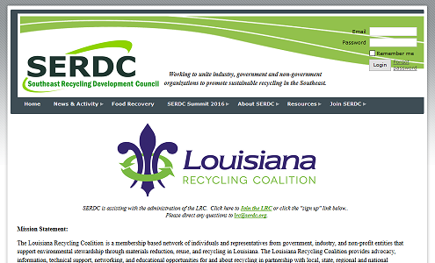
Membership Dues and Sponsorship
http://serdc.org/LouisianaRecyclingCoalition

Slide 50
How We’re Funded
Member Dues Levels
Sponsor Levels
$20 – student
$35 – individual
$60 – non-profits
$100 – small business, institutions state and local government
$200 - large business, institutions
$500 – Gold Level – Logo included in LRC Newsletter
$1000 – Silver Level – Logo included in LRC Newsletter and small logo on our website
$2000 – Bronze Level – Logo included in LRC Newsletter and large logo on our website

Slide 51
Questions and Feedback
Contact the louisiana recycling coalition:
LRC@SERDC.org

